Slide 1
Solar photovoltaic (PV)
PowerPoint presentation
Unit 301: Understand the fundamental principles and requirements of environmental technology systems

Slide 2
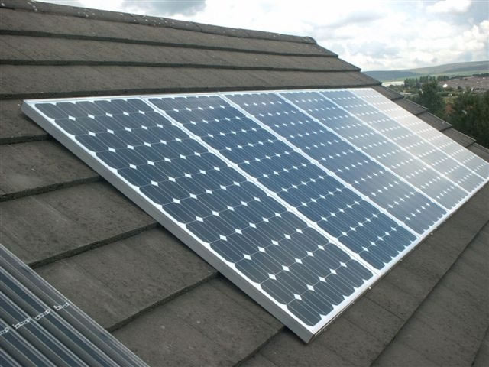
Solar photovoltaic (PV)
PV cells are made from layers of semi-conducting material, usually silicon.
When light shines on the cell it creates an electric field across the layers.
The stronger the sunshine, the more electricity is produced.
Groups of cells are mounted together in panels or modules that can be mounted on your roof.

Slide 3
Solar photovoltaic (PV)
The power of a PV cell is measured in kilowatts peak (kWp).
That's the rate at which it generates energy at peak performance in full direct sunlight during the summer.
PV cells come in a variety of shapes and sizes.
Most PV systems are made up of panels that fit on top of an existing roof, but you can also fit solar tiles.

Slide 4
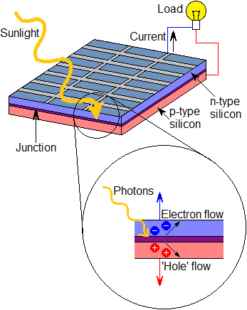
Solar photovoltaic (PV)
The solar PV cell operation is based on the ability of specifically engineered semiconductors to convert the absorbed energy from sunlight d.c. (direct current) electricity.

Slide 5
Solar photovoltaic (PV)
In the conversion process, the incident energy of the sun’s light creates electrically charged, free electrons in the solar cell, which are then separated by the engineered semiconductor’s (solar cell’s) internal structure to produce electrical current which is collected to an external electrical load.

Slide 6
Solar photovoltaic (PV)
Solar inverters, also called grid-tied inverters, convert the direct current (d.c.) electricity produced by your solar PV panels to alternating current (a.c.) electricity that can be used in the home and exported back to the grid.

Slide 7
Solar photovoltaic (PV)
Solar invertors also:
ensure compliance with regulations about feeding electricity into the grid, for example by immediately disconnecting if there is a power cut
maximise electricity production by constantly varying its resistance (load).
Solar inverters are very efficient, usually 93–96% depending on the make and model – never 100% because they use some of the input d.c. power to run, generally around 10–25W.

Slide 8
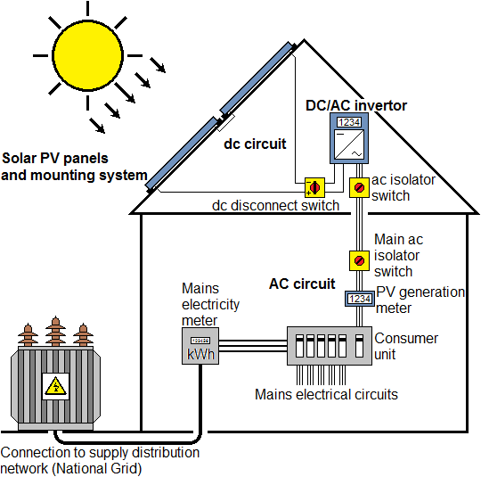
Solar photovoltaic (PV)

Slide 9
Installation considerations
The first consideration, is there a suitable place for the panels?
Usually these are fitted to the roof but they can be fitted to a wall or anywhere else where they can be supported, providing they face between south east and south west at an appropriate angle.

Slide 10
Installation considerations
The roof should ideally face due south at a pitched angle of around 30° from the horizontal to give the best overall annual performance.
Installations at any pitch and facing anywhere to the south of due east and due west are feasible, although output and income will be reduced.
Installation is not recommended on roofs facing north.

Slide 11
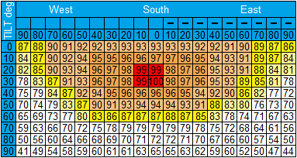
Installation considerations
This table shows the percentage of the ideal annual output you will get for a system with a different orientation and tilt:

Slide 12
Planning permission
In England, Wales and Scotland, you don't need planning permission for most home solar electricity systems.
Permitted development rights for solar PV (roof mounted).
Permitted unless:
panels protrude more than 200mm when installed
your local Building Control Office may want to check that your roof structure is suitable.

Slide 13
Building Regulations requirements
The installation of solar PV panels on the roof on a house needs to comply with Building Regulations including Part A on Structural Safety.
If the loading to the roof is increased by 15% or more, this is a material alteration, so a formal Building Regulation approval is required.

Slide 14
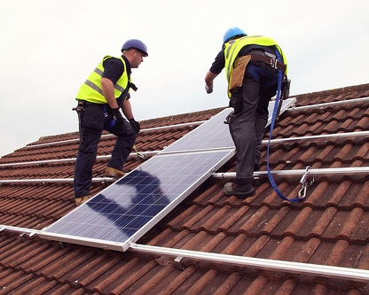
Advantages of solar photovoltaic (PV)
Benefit from the Governments feed‑in tariff.
The feed-in tariff is guaranteed by the Government for 20 years.
Panels designed for European countries generate power even on cloudy days.
Clean energy means carbon emissions can be reduced.
Producing your own power protects against rising energy prices.
Once installed requires very little maintenance.

Slide 15
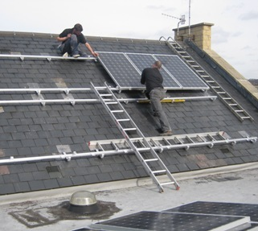
Disadvantages of solar photovoltaic (PV)
A large area of unshaded south, south-west or south-east facing roof is required to maximise payback. Smaller systems can be installed but payback will be longer.
Panels degrade over time by approximately 20% over 25 years; this however is taken into account in most reputable suppliers calculations.
It may be beneficial to replace the inverter after 10 years to optimise power generation, although this is not essential.

Slide 16
Any questions?

